Slide 1
Computer Modeling and Simulation
Lectures 3,4 and 5

Slide 2
Dynamic Systems
Dynamic vs Static Systems
Dynamic Systems
Continuous Systems
Systems with rate proportional to the amount
Population growth models
Unconstrained
Constrained
Drug Dosage Model
Force and Motion
Random Walk
Discrete Systems
Discrete Event Systems

Slide 3
Dynamic Systems
Dynamic systems are those that change with time.
Examples:
population of humans, deer or bacteria etc. changing with time
Motion of vehicles (position and speed changing with time)
Number of people standing in a queue in front of a service counter changes with time
Types of Dynamic Systems
Continuous Systems
Discrete Event Systems

Slide 4
Continuous Systems
A continuous system is one in which the state variable(s) change continuously over time. E.g. the amount of water flow over a dam.
Figure
Continuous systems are represented by Differential Equations.

Slide 5
Differential Equations
A differential equation is an equation which contains one or more terms and the derivatives of one variable (i.e., dependent variable) with respect to the other variable (i.e., independent variable)
dy/dx = f(x)
Here “x” is an independent variable and “y” is a dependent variable
For example, dy/dx = 5x
The derivative represents a rate of change, and the differential equation describes a relationship between the quantity that is continuously varying with respect to the change in another quantity.
The derivate can be either partial derivatives or ordinary derivatives.

Slide 6
Ordinary Differential Equation

Slide 7
Rate of change
How much a system variable changes with change in time
Average rate of change
Instantaneous rate of change
Average rate of change

Slide 8
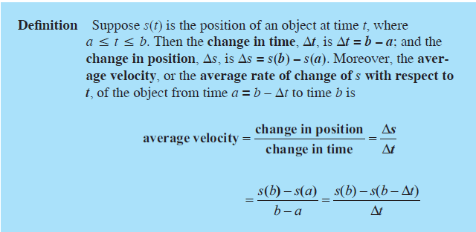
Average rate of change

Slide 9
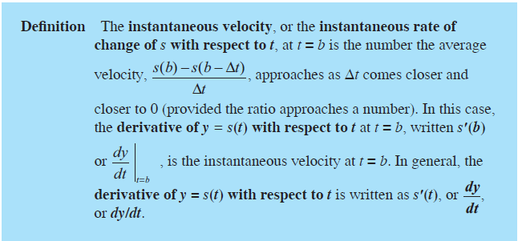
Instantaneous rate of change

Slide 10
Continuous Systems
Systems where the change in the system variable is proportional to the quantity of that system variable
Population growth models
Profits on income
Drug dosage model

Slide 11
Population Growth Model
Carrying Capacity:
The maximum population size of a biological species that can be sustained by that specific environment given the food, habitat, water, and other resources available.
Unconstrained Growth Model
The carrying capacity is infinite
Constrained Growth Model
Is defined by a certain carrying capacity

Slide 12
Unconstrained Growth Model (Malthusian Model)
Thomas Malthus gave the Malthusian Model in “An Essay on the Principle of Population (1798)”
Popular definition of ”Malthusian”: population growth exponentially and food grows linearly
This would lead either to catastrophe or to the existence of natural (not nice) stabilization mechanisms.

Slide 13


Malthusian Models
No constraints, such as competition for food or a predator, exist on growth of the population
The model where the rate of change of the population is directly proportional (∝) to the number of individuals in the population.
The constant r is the growth rate, or instantaneous growth rate, or continuous growth rate, while dP/dt is the rate of change of the population.

Slide 14
Differential Equation
Consider a bacterial population of size 100, an instantaneous growth rate of 10% = 0.10, and time measured in hours. Thus, we have
dP / dt = 0.10P
with P₀ = 100.
A solution to this differential equation is a function, P(t), whose derivative is 0.10P(t), with P(0) = 100.

Slide 15
Variables in the Growth Population Model
A stock (box variable, or reservoir), such as population, accumulates with time.
By contrast, a converter (variable-auxiliary/constant, or formula), such as growth_rate, does not accumulate but stores an equation or a constant.
The growth is the additional number of organisms that join the population. Thus, a flow (rate), such as growth, is an activity that changes the magnitude of a stock and represents a derivative.
Because both population and growth rate are necessary to determine the growth, we have arrows (connectors, or arcs) from these quantities to the flow indicator.

Slide 16
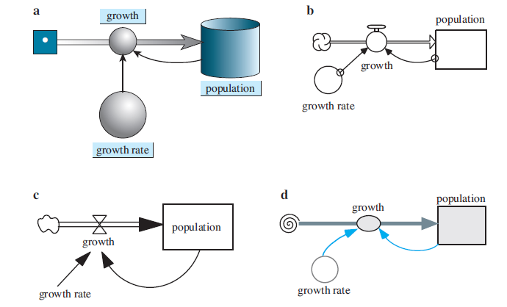
Graphical representation of model
Diagrams of population models where growth rate is proportional to population:
(a) Berkeley Madonna® (b) STELLA® (c) Vensim PLE® (d) Text’s format

Slide 17
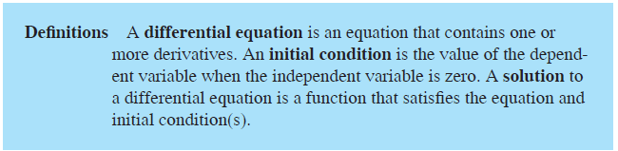
Differential Equation

Slide 18
Solution to Differential Equations
Analytical Solution using Integration
Numerical Methods

Slide 19


Analytical Solution Using Integrals
We can solve the differential equation dP/dt = = 0.10P using a technique called separation of variables.
Then, we integrate both sides of the equation, as follows:

Slide 20
Analytical Solution Using Integrals
We can solve the differential equation dP/dt = = 0.10P using a technique called separation of variables.
Then, we integrate both sides of the equation, as follows:

Slide 21
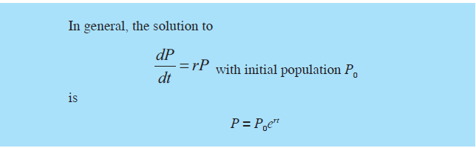

Slide 22
Numerical Methods
Numerical methods are used when the analytical solution is not possible.
Euler Method
Runge Kutta Method
In unconstrained growth model, we have the analytical solution but we will use the Euler method just to demonstrate the use of numerical methods in complex situations where the analytical solution doesn’t exist.

Slide 23
Finite Difference Equation
Euler method uses finite difference equations
(new population) = (old population) + (change in population)
or
population(t) = population(t – Δt) + Δpopulation
Δpopulation = population(t) - population(t – Δt)
The above equation is called a finite difference equation.
growth (dP/dt) = Δpopulation / Δtime
growth = (population(t) - population(t – Δt) )/ Δtime
Computer programs and system dynamics tools employ such finite difference equations to solve differential equations.

Slide 24
Euler’s method
growth_rate = 0.10
population(0) = 100
growth(t) = growth_rate * population(t - Δt)
population(t) = population(t - Δt) + growth(t) * Δt
Starting with P₀ = P(0) = 100 and using Δt = 8. In this situation, t = 8, t − Δt = 0, growth(t) is the derivative at that time is Pʹ(0) = 0.1(100) = 10, which is the slope of the tangent line to the curve P(t) at (0,100).
We multiply Δt, 8, by this derivative at the previous time step, 10, to obtain the estimated change in P, 80.
Consequently, the estimate for P₁ is as follows:
estimate for P₁ = previous value of P + estimated change in P
= P₀ + Pʹ(0)Δt
= 100 + 10(8)
= 180

Slide 25
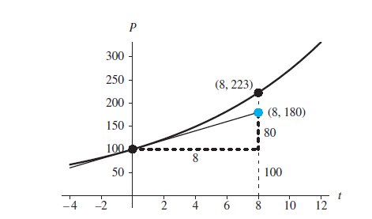
Actual point, (8, 223), and point obtained by Euler’s method, (8, 180)

Slide 26
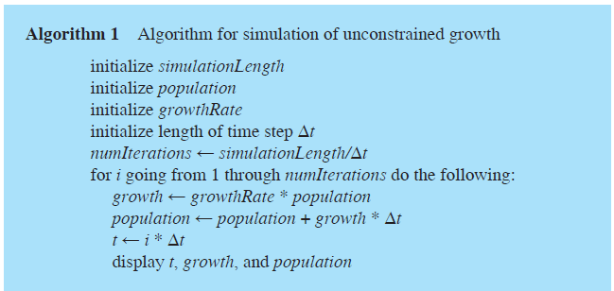
Simulation Program

Slide 27
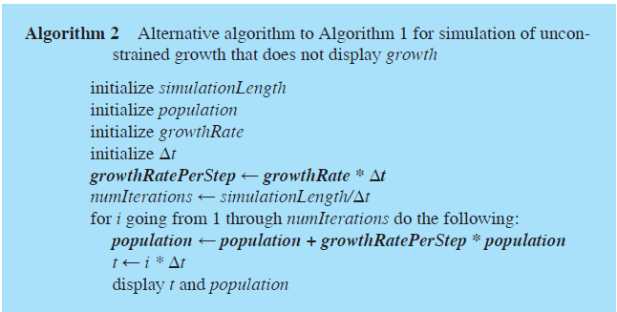
Simulation Program

Slide 28
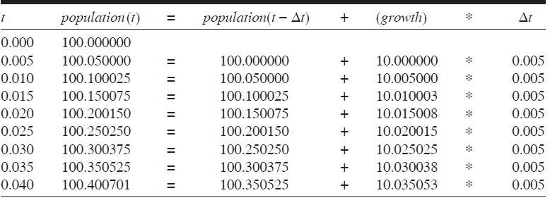
Numerical Solution by Euler’s Method
Table of Estimated Populations, Where the Initial Population is 100, the Continuous Growth
Rate is 10% per Hour, and the Time Step is 0.005 h

Slide 29
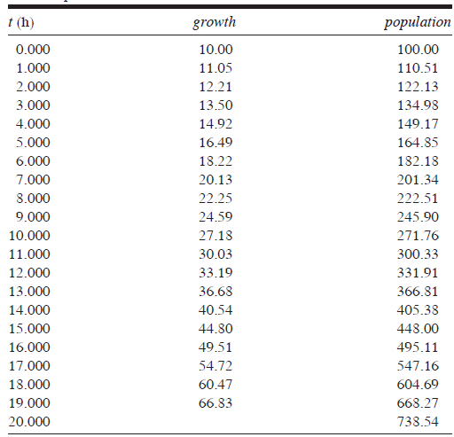
Table of Estimated Growths and Populations, Reported on the Hour,
Where the Initial Population is 100, the Growth Rate is 10%, and the
Time Step is 0.005 h

Slide 30
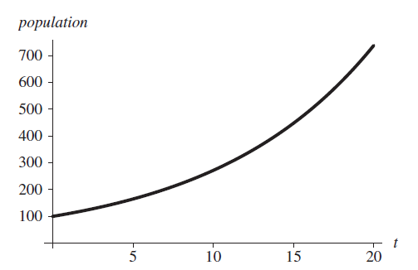
Graph Population vs time

Slide 31
Unconstrained Decay
The rate of change of the mass of a radioactive substance is proportional to the mass of the substance, and the constant of proportionality is negative. Thus, the mass decays with time.
For example, the constant of proportionality for radioactive carbon- 14 is approximately –0.000120968. The continuous decay rate is about 0.0120968% per year, and the differential equation is as follows, where Q is the quantity of carbon-14.
dQ/dt = −0.000120968Q

Slide 32
Unconstrained Decay - Example
The analytical solution to this equation is
Q = Q₀e^{-0.000120968t}
After 10,000 years, only about 29.8% of the original quantity of carbon-14 remains, as the following shows:
Q = Q₀e^{-0.000120968(10,000)} = 0.298292Q0
Carbon dating uses the amount of carbon-14 in an object to estimate the age of an object. All living organisms accumulate small quantities of carbon-14, but accumulation stops when the organism dies. For example, we can compare the proportion of carbon-14 in living bone to that in the bone of a mummy and estimate the age of the mummy using the model.

Slide 33
Reports for System Dynamics Models
a. Analysis of the problem: We begin by describing the problem, such as to model the growth of bacteria in media.
b. Model design: In this section, we should list simplifying assumptions, such dt/dp= 0.10P with P₀ = 100; reasoning for choices of constants, such as an instantaneous growth rate of 10%; the basic time step, such as hour; and other units. A diagram of the model, such is also appropriate to include.
c. Model solution: This part should contain the analytical solution or an algorithm
d. Results and conclusions: Part d should include simulation tables, such as and graphs. Moreover, the section should contain an explanation of verification accomplished by comparing the results to real data when available, descriptions of the outcomes of various scenarios, a discussion of our conclusions with support from the results, and suggestions for model refinement.
e. Appendices: Usually, a copy of the file created with a system dynamics tool should be submitted with this report. Besides the model, this file should contain appropriate documentation, such as a text box with the authors’ names, date, module and problem number, and problem description.

Slide 34
Constrained Growth Model
Endemic populations increase rapidly at first, but they eventually encounter resistance from the environment— competitors, predators, limited resources, and disease.
Thus, the environment tends to limit the growth of populations, so that they usually increase only to a certain level and then do not increase or decrease drastically unless a change in the environment occurs.
This maximum population size that the environment can support indefinitely is termed the carrying capacity.

Slide 35

Carrying Capacity
In unconstrained growth model, we have
When the population is very small, the number of deaths be almost zero, indicating that few individuals are dying.
Near the carrying capacity, the number of deaths should be almost equal to the number of births, so that the population remains roughly constant.
For populations larger than the carrying capacity, the fraction should be even larger so that the population decreases in size through deaths.
To accomplish this dampening of growth, we could compute the number of deaths as a changing fraction of the number of births.
This fraction is P/M where P is the population at any instant and M is carrying capacity.

Slide 36


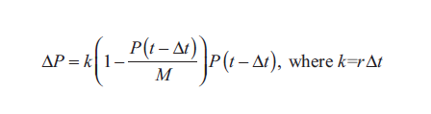
Logistic Equations
Thus, we can model the instantaneous rate of change of the number of deaths (D) as the fraction P/M times the instantaneous rate of change of the number of births (r), as the following differential equation indicates:
1
2

Slide 37
Carrying Capacity
Differential equation (1) and difference equation (2) are called logistic equations.
An equilibrium solution for a differential equation is a solution where the derivative is always zero. An equilibrium solution for a difference equation is a solution where the change is always zero.

Slide 38
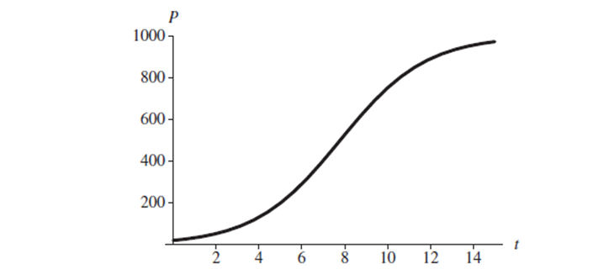
Graph of logistic equation where initial population is 20, carrying capacity is 1000
and instantaneous rate of births is 50% with time in years

Slide 39
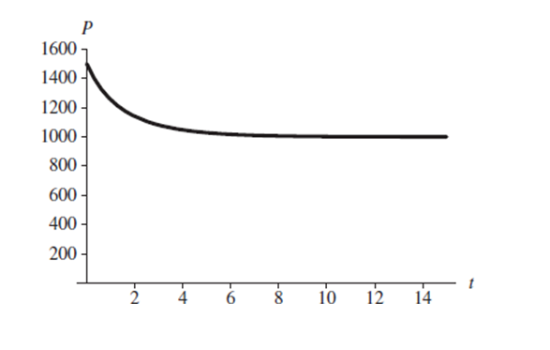
Graph of logistic equation where initial population is 1500, carrying capacity is 1000
and instantaneous rate of births is 50% with time in years

Slide 40
Drug dosage Model
Errors in the dispensing and administration of medications occur frequently. Although most do not result in great harm, some do.
There are prescribed dosages for various drugs, but how do we determine what the correct/effective dosage is?
Metabolism of a drug in the human body is a complex system to represent in a model. Thus, in Step 2 of the modeling process, particularly for our first attempt, we should make simplifying assumptions about the drug and the body.
A one-compartment model is a simplified representation of how a body processes a drug.

Slide 41
One-Compartment model
In this model, we consider the body to be one homogeneous compartment, where distribution is instantaneous, the concentration of the drug in the system (amount of drug/volume of blood) is proportional to the drug dosage, and the rate of elimination is proportional to the amount of drug in the system.
The concentration of a drug instead of the absolute quantity is important because a quantity that might be appropriate for a small child could be ineffective for a large adult.

Slide 42
One-Compartment model
A drug has a minimum effective concentration (MEC), which is the least amount of drug that is helpful, and a maximum therapeutic concentration, or minimum toxic concentration (MTC), which is the largest amount that is helpful without having dangerous or intolerable side effects.
The therapeutic range for a drug consists of concentrations between the MEC and MTC.
A drug’s half-life, or the amount of time for half the drug to be eliminated from the system, is useful for modeling as well as patient treatment.
Often concentrations and half-life are expressed in relationship to the drug in the plasma or blood serum.

Slide 43
One-Compartment model
To compute aspirin’s plasma concentration (plasma_concentration) in a converter (variable), we have another converter for the volume of the system (plasma_volume) with a value of 3000 mL and appropriate connectors and equation.
elimination = elimination_constant * aspirin_in_plasma
plasma_concentration = aspirin_in_plasma/plasma_volume

Slide 44
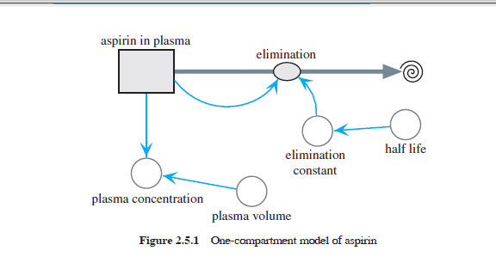

Slide 45
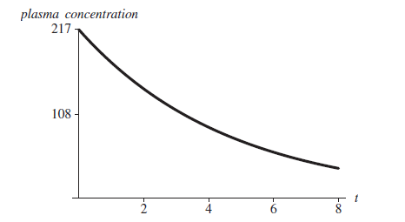
Graph of plasma_concentration (μg/mL) for aspirin versus time, t (h)

